Slide 1
Notation for Query Trees
Query tree
Query execution tree or query evaluation tree
How queries are represented internally in relations systems
Query tree is a tree data structure that corresponds to the relational algebra expression
It Represents the input relations of query as leaf nodes of the tree
It Represents the relational algebra operations as internal nodes

Slide 2
Expression Tree
Example :What are the titles and years of movies made by Fox that are at least 100 minutes long”
Select those movies tuples that have length >= 100
Select those movies tuples that have studioName = “Fox”
Compute the intersection of 1 and 2 above
Project the relation from 3 onto attributes titles and years
∏_{title, year}
∩
σ_{length >= 100}
σ_{studioName = ‘Fox’}
Movies
Movies
∏_{title, year} (σ length >= 100 AND studioName = ‘Fox’ (Movies))

Slide 3
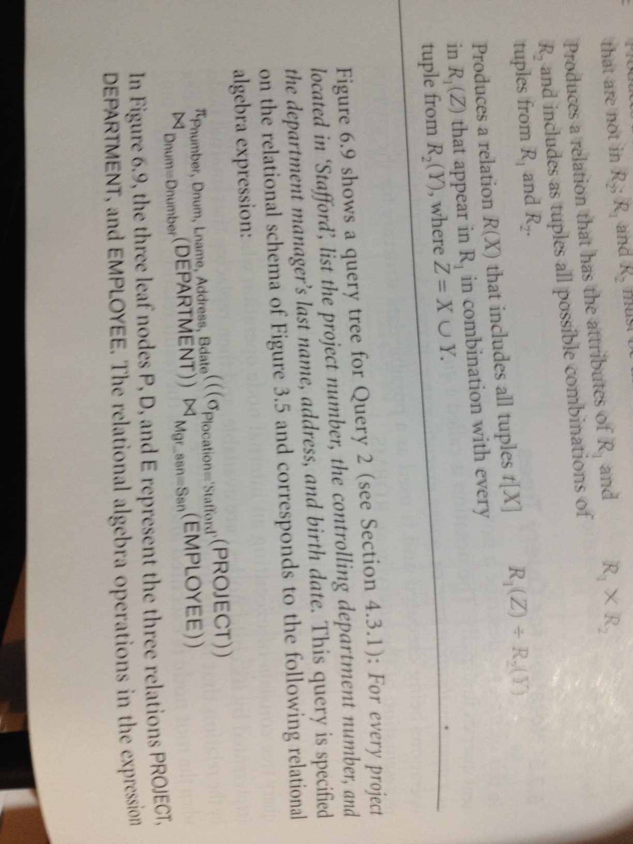
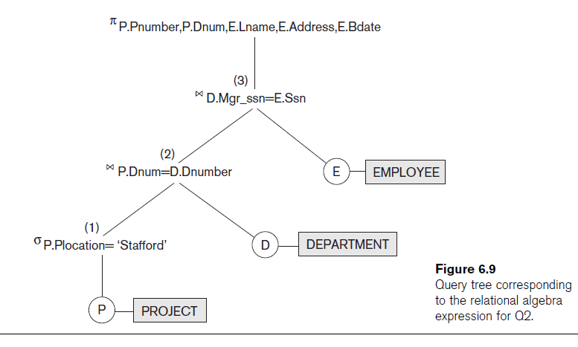

Slide 4
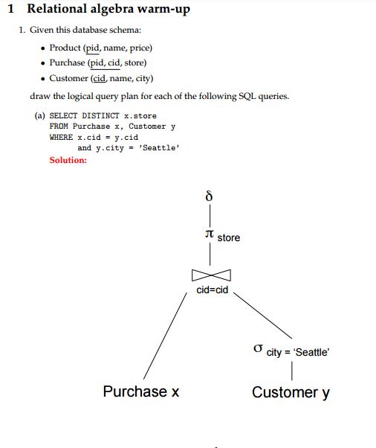

Slide 5
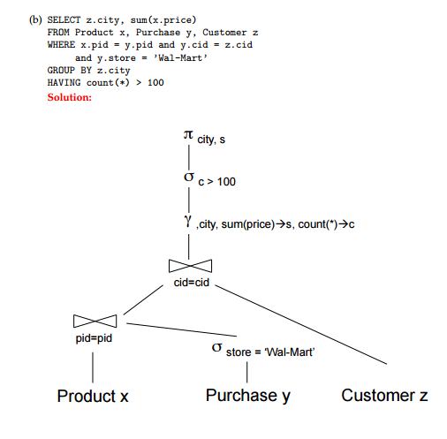

Slide 6
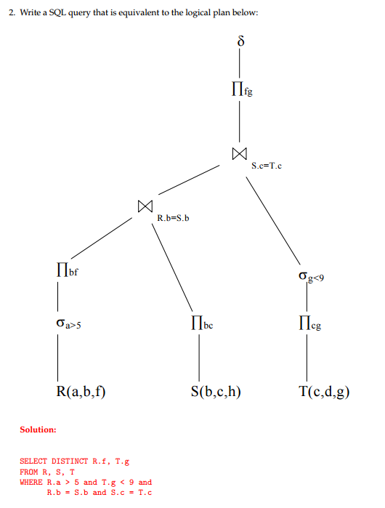

Slide 7
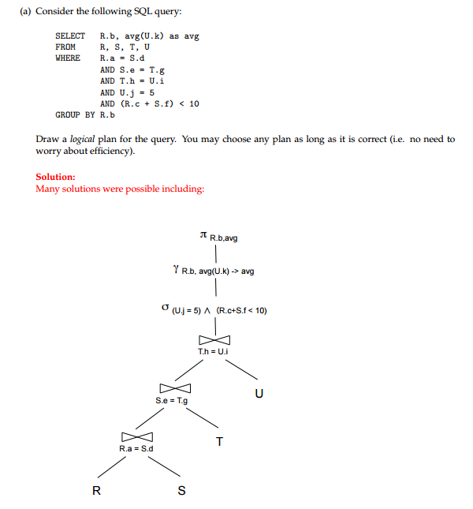

Slide 8
